Slide 1
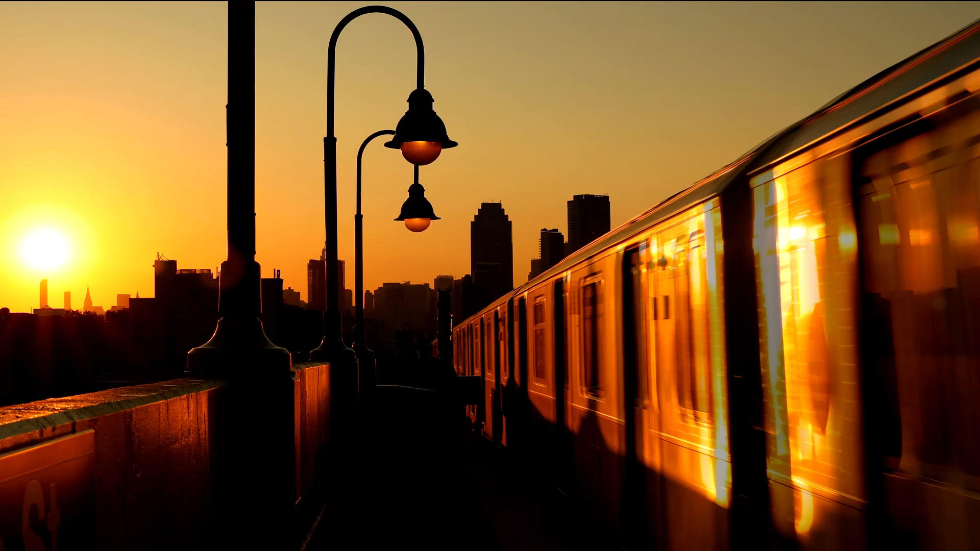
Lahore Orange Line Metro Train System
A Critical Project Review
Presented by:
Muhammad Umer | Syeda Fatima Zahra | Fasih Ul-Hassan
Danial Ahmad | Hassan Rizwan

Slide 2
Introduction
Rapid urbanization has created both challenges and opportunities for the masses
Efficient urban transportation system plays an important role in facilitating commute of people, while also aiding the country’s economy
The Lahore Orange Line Metro System is a project undertaken under CPEC
It is the first mass transit project of Pakistan
The goal was to provide a transport service while finding a suitable tradeoff between affordability and financial sustainability

Slide 3

Incentives for OLMT
The Lahore Orange Line Metro Train (OLMT) System project involved collaboration and funding from various entities
Federal Government of Pakistan
Punjab Provincial Development Working Party
Punjab Government
China-Pakistan Economic Corridor (CPEC)
Chinese Government

Slide 4

Overview of OLMT
OLMT provides a modern, efficient, and much-needed public transportation solution to reduce crowding and enhance connectivity in Lahore
Total Length | 27.1 km
Total Stations | 26
Ridership | 245,000 passengers / day
Purpose | Aimed at alleviating traffic blocking and providing a modern, efficient mode of public transportation

Slide 5
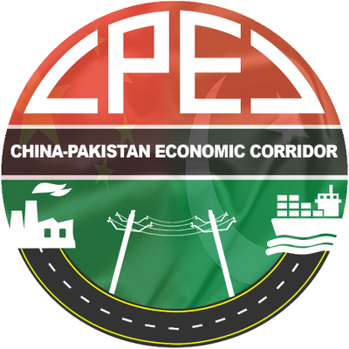

Partners & Collaborators
OLMT involved collaboration and funding from various entities
Federal Government of Pakistan
Punjab Provincial Development Working Party
Punjab Government
China-Pakistan Economic Corridor (CPEC)
Chinese Government

Slide 6

Construction Challenges
Land Acquisition and Resettlement
Densely populated urban areas, posing resettlement complexities
Several private owners contested the acquisition process, resulting
in court orders halting construction and further delays
Heritage Conservation
Design route passed near historical landmarks, sparking controversy and protests
Proximity to historical sites amplified challenges
Project Management and Governance
Frequent changes in the project's design and scope due to funding and technical complexities
Concerns were raised about the lack of transparency financial dealings and decision-making
Legal Issues
Court orders halting construction due to land acquisition disputes

Slide 7
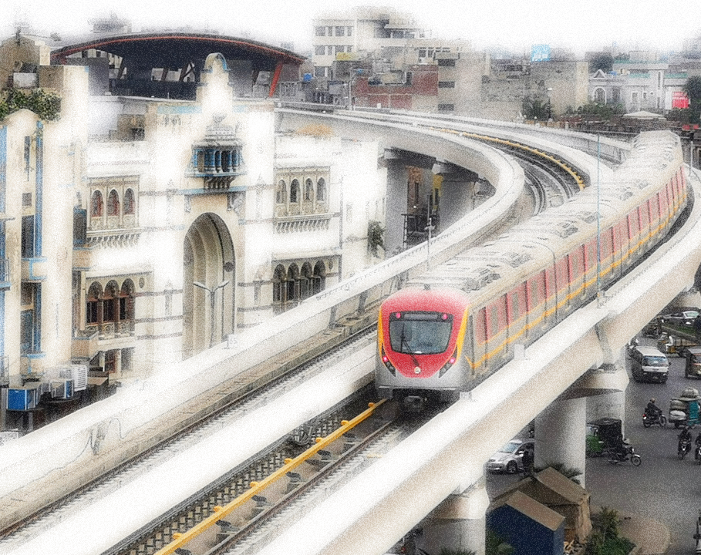
Project Completion
Construction began in 2015 and was officially inaugurated on October 25, 2020
Faced delays due to land acquisition and financial constraints
The system consists of 26 stations, connecting Dera Gujran in the north to Ali Town in the south

Slide 8
Project Success Determination
Time | Budget
OLMT's initial 2017 completion date was missed, however, it eventually launched in 2020 Critics emphasize the 3-year delay, causing cost overruns and inconvenience | Project's estimated cost was USD 1478.18 million Delays and challenges in construction escalated the premium cost of the project by 50 percent
Performance | Social Acceptance
Averaging 200,000 daily passengers, exceeding initial projections Reduced travel time by 75%, improved air quality, and boosted economic activity along the corridor | Mixed, with praise for convenience and criticism of cost and land acquisition issues Recent surveys indicate rising satisfaction with the train's convenience and reliability

Slide 9

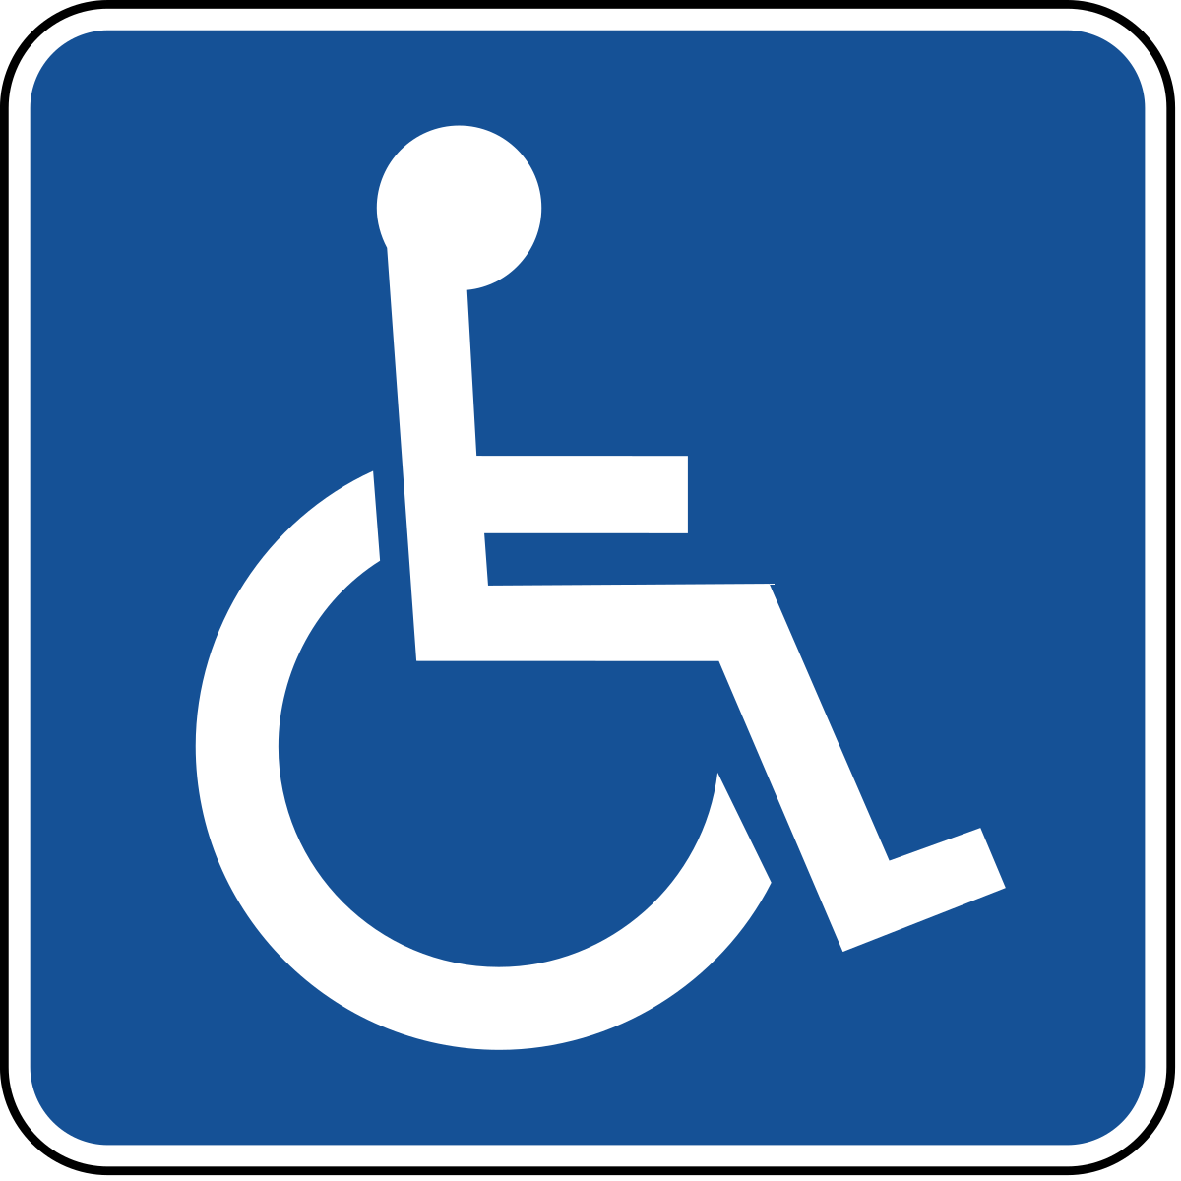
Local Impact
Positives
Cheap means of transport– Every day, approximately 200,000 people commute using the orange train daily
Reduced congestion – Promoting public transport and reducing Congestion on roads, making traffic flow much easier and smoother
Negatives
Unsafe working conditions – In January of 2017, the residence of workers caught fire and killed 7 workers, 14 injured
Accessibility for Persons with Disabilities – Further improvements are needed to better accommodate individuals with disabilities

Slide 10
Environmental & Economic Impact
Environmental
Positives
Reduced air pollution - From fewer vehicles on the road, the potential for saving energy by promoting public transport
Negatives
Energy consumption – Daily cost of Rs. 2.5 crore for electricity raises concerns about sustainability.
Construction Pollution – High noise and fuel pollution during construction
Economic
Positives
Employment - Created 7000 jobs, while 2000 more during operation and maintenance
Negatives
Losing Money - An overall economic loss for the state, Rs. 10 billion per year (Rs. 30 million per day)
Ticket Price vs. Losses – An article published in 2020 stated that each ticket must be sold for Rs. 280 to avoid losses

Slide 11
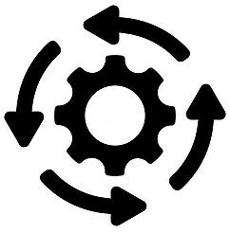
Current Operational Status
Operational 16 hours every day
Subsidized tickets
Equipped with state-of-the-art infrastructure
Connected to Lahore Metrobus (Speedo) & Railway station
Future Plans
More trains to be brought to service by 2025
Aim to merge with Blue and Purple line

Slide 12
Comparison with Delhi Metro (Green Line)
 | Orange Line Lahore Metro | Green Line Delhi Metro
Length | 27 km | 29 km
Rolling stock | 5-car trains | 4-car trains
Capacity per train | 2200 | 1200
Average speed | 80 km/h | 55 km/h
Completion delay | 3 years delay | 2 years advance
Price | $59 million/km | $25 million/km
Higher Cost Factors
Change in government leadership & project priorities
Stay order from courts
Better infrastructure used (faster, spacious trains)

Slide 13

Conclusion
Project was a “success”
Largest public transport project to date in Pakistan
Reduce cost overheads, bureaucratic hurdles
Similar public transport projects required
Replicate the project in other metropolitan cities (Multan, Karachi, etc.)
Integrate public transport systems (Speedo buses, Metro bus, Orange lines)

Slide 14
Thank You
Any Questions?

